Slide 1
Preliminary Results of a Systematic Review
Quality Assessment of Conversational Agents (Chatbots) for People with Disabilities or Special Needs
Presenter: Maria Laura De Filippis
Notes:
Hi I am Maria Laura defilippis and I am going to present today a work titled: “Preliminary Results of a Systematic Review
Quality Assessment of Conversational Agents (Chatbots) for People with Disabilities or Special Needs

Slide 2
The team
Maria Laura De Filippis, Stefano Federici, Maria Laura Mele, Marco Bracalenti University of Perugia (IT)
Simone Borsci University of Twente (NL), Imperial College and Hertfordshire University (UK)
Giancarlo Gaudino, Antonello Cocco, Massimo Amendola Superior Institute of Communication and Information Technologies, Ministry of Economic Development (IT)
Emilio Simonetti Department of Public Service, Prime Minister’s Office (IT)
Notes:
This research is part of a collaboration between different institutes and research centers: Including University of Perugia (IT); University of Twente (NL), Imperial College and Hertfordshire University (UK); the superior Institute of Communication and Information Technologies of Ministry of Economic Development (IT) and Department of Public Service of the Prime Minister’s Office of italy

Slide 3
Chatbots and conversational agents
Notes:
Chatbots are intelligent conversational software agents, which can interact with people using natural language dialogue. They are extensively used to support interpersonal services, decision making, and training in various domains. There is a broad consensus on the effectiveness of these agents, particularly in the field of health, where they can promote recovery, adherence to treatment, and training for the preparation of different abilities and the maintenance of well-being

Slide 4
Key issues
It is yet unclear:
how quantify the objective and subjective dimensions of experience with chatbots in a reliable and comparable
How to compare the quality of interaction with different chatbots
Notes:
While some qualitative guidelines and tools have emerged, it is still hard to find agreement on which factors should be tested. As argued by researchers, the implementation of these innovative systems should be based on a common framework for assessing the perceived interaction quality, in order to prevent chatbots from being regarded by their end-users as merely another source of social alienation, and being discarded in the same way as any other unreliable assistive technology.
The need to quantify the objective and subjective dimensions of experience in a reliable and comparable manner, which is a key aspect in human computer interaction exchanges, is unsatisfied.
Chatbot developers are forced to rely on the umbrella framework provided by the International Organization for Standards (ISO) 9241-11 for assessing usability, and ISO 9241-210 for assessing user experience (UX), due to the absence of a common assessment framework that specifies comparable evaluation criteria.
The point is how these two standards are applied to assess the quality in interaction with chatbots?

Slide 5
Goal
Review how AI-based agents for people with disabilities or special needs are assessed
i.e., how key factors of usability and UX are assessed?
Notes:
The goal of the present work was to review in a systematic way how aspects of perceived interaction quality are assessed in studies of AI-based agents that support people with disabilities or special needs.

Slide 6
Key questions
How are the key factors of usability measured and reported (ISO 9241-11)?
How are factors relating to UX measured and reported (ISO 9241-210)?
Notes:
To determine whether and how the quality of interaction with chatbots was evaluated in line with standards of usability and UX, this review sought to answer the following research questions:
How are the key factors of usability (efficiency, effectiveness, and satisfaction) measured and reported in evaluations of chatbots for people with disabilities or special needs?
How are factors relating to UX measured and reported in assessments of chatbots?

Slide 7
Methods
Inclusion criteria:
Exclusion criteria:
chatbots or conversational agents for PWDSP
in the title, abstract, keywords or main text;
included empirical findings and factors
testing emotion
detecting the development of disability conditions;
chatbots supporting people with alcoholism, anxiety, etc.
the assessment of compliance with treatment,
the ethical and legal implications
Notes:
We performed a review by following the PRISMA guidelines.
We included:
(i) items that referred to chatbots or conversational interfaces/agents for people with disabilities or special needs in the title, abstract, keywords or main text;
(ii) empirical findings and discussions of theories (or frameworks) of factors that could contribute to the perceived quality of interaction with chatbots, with a focus on people with various types of disability.
Concurrently, we excluded all those records that did not include at least one group of end-users with a disability in either the testing or the design of the interaction, and studies that focused on:
testing emotion recognition during the interaction exchange, or assessing applications for detecting the development of disability conditions or disease;
chatbots supporting people with alcoholism, anxiety, depression or traumatic disorders;
(iii) the assessment of end-user compliance with clinical treatment, or assessment of the clinical effectiveness of using AI agents as an alternative to standard care, without considering the interaction exchange with the chatbot; and
(iv) the ethical and legal implications of interacting with AI-based digital tools.
Records were retrieved from Scopus and the Web of Science using the Boolean operators to combine the following keywords: chatbot*, conversational agent*, special needs, disability* etc. We searched only for English language articles.

Slide 8
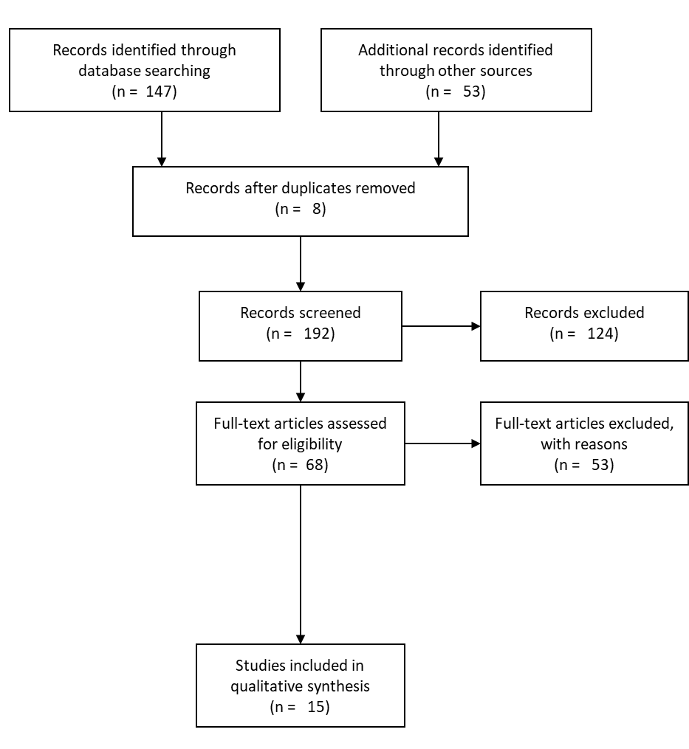
Results (1)
192 items were reduced to 15:
80% autism and mental disabilities,
20% focused on support the general health or training of people with a wide range of disabilities.
Notes:
The initial 192 items were reduced to 15 that matched our inclusion and exclusion criteria:
80% examined AI agents in terms of supporting people with autism and (mild to severe) mental disabilities,
20% focused on the testing of applications to support the general health or training of people with a wide range of disabilities.

Slide 9
Results (2)
Goals of the included studies:
66.6%: applications support health and rehabilitation,
33.4%: solutions to support learning and training.
Approaches of the included studies :
46.7% surveys or questionnaires,
26.7% quasi-experimental procedure,
26.7% tested chatbots using randomized controlled trials.
Notes:
Among the selected studies the declared goals was:
In 66.6% of the cases to develop and test applications support health and rehabilitation,
In 33.4% of the cases to develop and test solutions to support learning and training.
In terms of approaches the included studies used:
In 46.7% surveys or questionnaires,
In 26.7% quasi-experimental procedure,
And finally in 26.7% tested chatbots using randomized controlled trials.

Slide 10
Discussion (1) Assessment of chatbots’ usability
Effectiveness is the most tested factor (80% of the studies)
26.7% of the studies also investigated efficiency mainly by time to perform and resources invested to achieve goals.
Only 20% referred a structured way of assessing satisfaction with a validated scale. In several occasion practitioners adapted a standardized tools or used a qualitative scale
Notes:
Our results indicated that in terms of Usability:
80% of the studies tested the effectiveness of chatbots according to the ISO standard, intended as the ability of the app to perform correctly, allowing the users to achieve their goals.
Only 26.7% of the studies also investigated efficiency, by measuring performance in terms of time or factors relating to the resources invested by participants to achieve their goals.
Finally just for 20% referred to an intention to gather data on user satisfaction in a structured way, and only one study used a validated scale. In another, practitioners adapted a standardized questionnaire without clarifying the changes to the items..

Slide 11
Discussion (2) Assessment of chatbots’ UX
Acceptability is the most frequent measure of UX (26.7% of the studies). However, this was measured in a qualitative and unstandardized way, or even in a wrong way e.g., lack of complaints.
The remained studies tested various factors in qualitative way e.g. overall experience, safety, acceptability, engagement, intention to use, ease of use, helpfulness, enjoyment, and appearance.
Notes:
Assessment of chatbots’ UX showed that:
- Acceptability is the most frequent measure of UX (26.7% of the studies). However, this was measured in a qualitative and unstandardized way, or even in a wrong way e.g., lack of complaints.
- The remained studies tested various factors in qualitative way e.g. overall experience, safety, acceptability, engagement, intention to use, ease of use, helpfulness, enjoyment, and appearance.

Slide 12
Conclusion
informal and untested measures of quality are often employed
The risk is that shortcomings in methods could significantly compromise the quality of chatbot usage, ultimately leading to the abandonment of applications that could otherwise have a positive impact on end-users.
Notes:
The results of the present study suggest that informal and untested measures of quality are often employed when it comes to evaluating user interactions with AI agents.
This is particularly relevant in the domain of health and well-being, where researchers set out to measure the clinical validity of tools intended to support people with disabilities or special needs. The risk is that shortcomings in these methods could significantly compromise the quality of chatbot usage, ultimately leading to the abandonment of applications that could otherwise have a positive impact on their end-users.

Slide 13
Take away
Lack of complaints is not a measure of satisfaction;
Safety and acceptability should be assessed with consolidated and comparable methodologies to rule out risks in use.
Satisfaction is a different construct from acceptability, and these two constructs should be measured separately with available standardized questionnaires.
A framework is needed, however, reliable methods and measures to assess interaction are available, and these should be adopted and used to enable the generation of comparable evidence regarding the quality of conversational agents.
Notes:
This systematic analysis suggested that:
Researchers tend to consider a lack of complaints as an indirect measure of the safety and acceptability of tools.
Safety and accept-ability should be assessed with consolidated and comparable methodologies to rule out risks in use.
Satisfaction, intended as a usability metric, is a different construct from acceptability, and these two constructs should be measured separately with available standardized questionnaires.
Although dedicated tools and methods for assessing the quality of interaction with chatbots are lacking and a comprehensive framework is needed, reliable methods and measures to assess interaction are available, and these should be adopted and used to enable the generation of comparable evidence regarding the quality of conversational agents.

Slide 14
Thank you!

